Slide 1
Level Calibration Analysis
Prepared by
Rick Ales
5/20/2025

Slide 2
Overview
This analysis has two parts:
Analysis of the individual measurement Repeatability & Reproducibility.
Analysis of the goodness of a 5-point calibration.
The coefficients of the best fit of the composite measurements (all 60 observations) is considered the best estimate of the true calibration coefficients, aka “Best Cal”.
The 5-point calibration is an evaluation to verify the “Best Cal” is still valid for testing to proceed.

Slide 3
Composite Data Set Measurements
DEFINITIONS
Obs Observation Number
Oper Operator ID
Rank Order of Variance from ANOVA
Operator Operator Name
Level Set Point 5 observation points per calibration, the Full point is fixed at 2.75”, Empty is fixed at 8.4” while the three intermediate points are the quintile levels +/- random amount ranging over 0.100”.
Laser Level Value read by the LK-G3000 Keyance Laser
Measure Level Value from the Depth Gage entered by the Operator
Cal ID the number assigned to a 5-point calibration
Goodness the maximum residual from 5-point calibration regression
Slope & Intercept coefficients resulting from 5-point calibration regression.

Slide 4
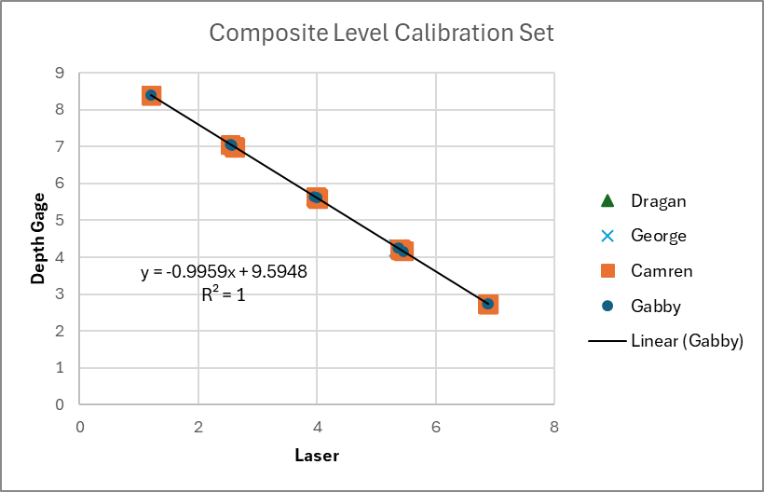
Composite Measurement Regression
Best estimate of calibration coefficients

Slide 5
Residual Plot & ANOVA Against Best Cal
ANOVA with Gabby
H₀: There is no reproducibility difference between operators.
H_{A}: There is a significant difference between operators.
Since P-value is > 0.05 can NOT reject H₀
**Post Hoc analysis show a significant difference between Dragan and Gabby (rank 1 to rank 4).

Slide 6
Compare Measurement Residuals with and without Gabby
Indicates there is a significant difference in the shape of the distribution tails.
ANOVA sans Gabby
H₀: There is no reproducibility difference between operators.
H_{A}: There is a significant difference between operators.
Since P-value is < 0.05 Reject H₀ Accept H_{A}
**Post Hoc Tukey analysis would be warranted to compare operators.

Slide 7
Composite Data Set Calibrations
DEFINITIONS
Full =7 This is the Lazer reading to give near Full Level measurement.
Empty=1.2 This is the Laser reading to give near Empty Level measurement.
Best Full Residual from this calibration fit to the Best Cal fit at the Full point.
Best Empty Residual from this calibration fit to the Best Cal fit at the Empty point.
The idea is to assess the individual 5-point calibrations against the Best Cal.

Slide 8
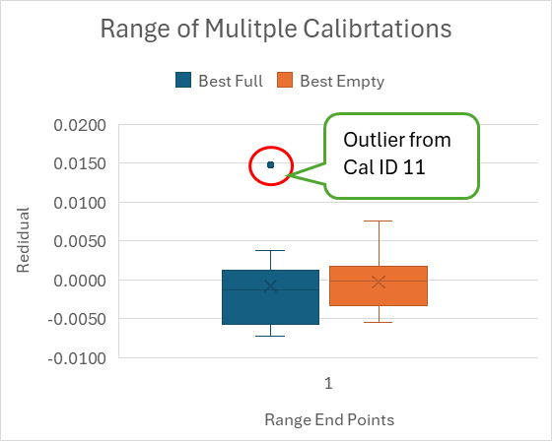
Calibration v Best Cal Residuals Statistics
Cal ID 11 with a “Goodness” score of 15 is suspect and generated this outlier. Should it be eliminated from the analysis?
Cal ID 8 with a “Goodness” score of 13 is marginal?

Slide 9
Calibration Full & Empty Reproducibility
H₀: There is no reproducibility difference between operators.
H_{A}: There is a significant difference between operators.
Since P-value is >> 0.05 can NOT reject H₀

Slide 10
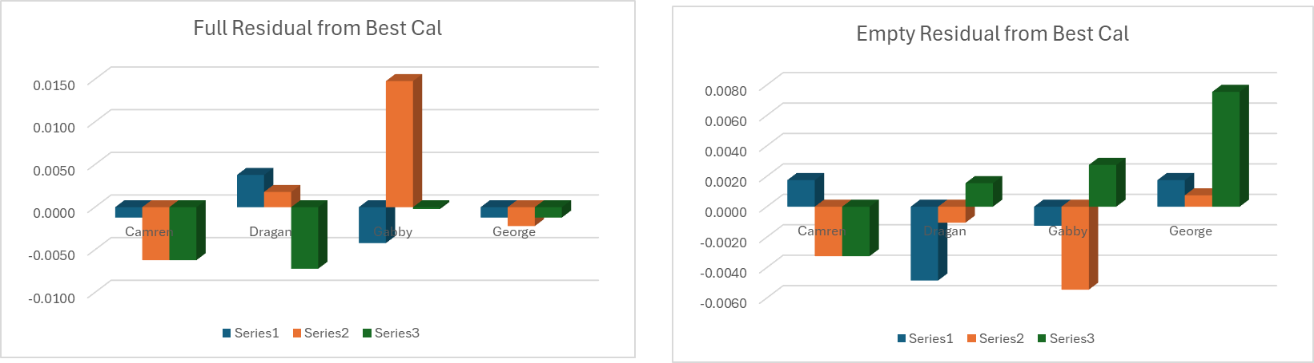
Calibration Full & Empty Reproducibility Plot

Slide 11
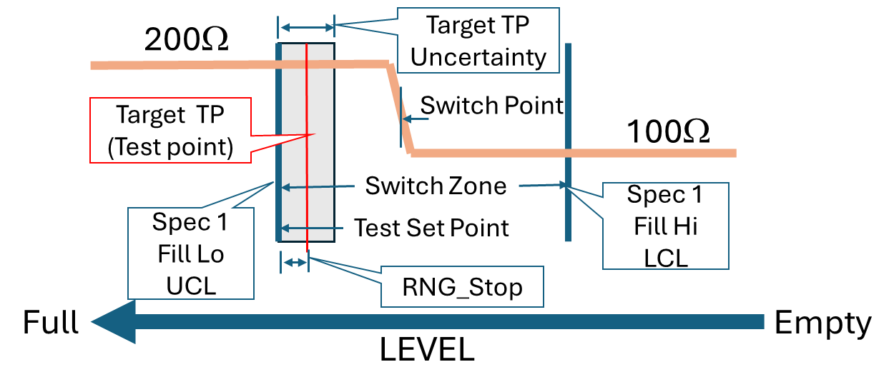
Conclusion
Determine what is the acceptable System Measurement Uncertainty to set Target TP (see below).
Need to determine the “Goodness” Criteria for flagging a calibration verification issue prior to ATP Test.
Target TP
Margin

Slide 12
